Slide 1
Containers, Cloud Native Computing, DevOps
Oxford University
Software Engineering Programme
April 2021

Slide 2
Contents
Containers
History and Approach
Docker
Docker ecosystem
PaaS in a container model
Futures

Slide 3
Sharing of resources vs Isolation
Dedicated data centre
Dedicated HW/ Shared Datacentre
More isolation
Virtual Machines
Containers
Shared OS Separate processes
Shared
Process
Better resource utilisation

Slide 4
Lightweight Virtualization history
zSystems Virtual Servers from late 1990s
(the mainframe really did do everything first)
Solaris Zones
AIX Workload Partitions
FreeBSD Jail
…

Slide 5
What is a Container?
A lightweight virtual server
Running within an Operating System
Providing various levels of isolation and control
E.g. Disk isolation and control
Network isolation
CPU and memory controls

Slide 6
Containers at Google
Every GMail session is a container
Try doing an export and then searching your email ☺
“Everything runs in a container”
2 billion containers launched a week
Borg
Any Google developer can instantiate their code in 10,000 instances any time they want
Takes about 5 minutes to start that many
Never exactly 10,000 because of failures

Slide 7

Cloud Native Computing Foundation
A new definition of “Cloud Native”
Container Packaged
Dynamically Managed
Micro-Service oriented

Slide 8
Docker on top of Containers
Docker adds several things to LXC and containerization:
Copy on write filesystem
Layered images and the ability to extend machines easily
Simple textual config file
Portable deployment across machines
Creating an ecosystem of images
Application centric
Each VM is a process (roughly speaking)
Plus others (auto-build, etc)

Slide 9
Why Docker?
The ecosystem has created a network effect
Metcalfe’s Law states
the value of a telecommunications network is proportional to the square of the number of connected users of the system
There is surely a corollary for ecosystems

Slide 10

How does Docker work?

Slide 11
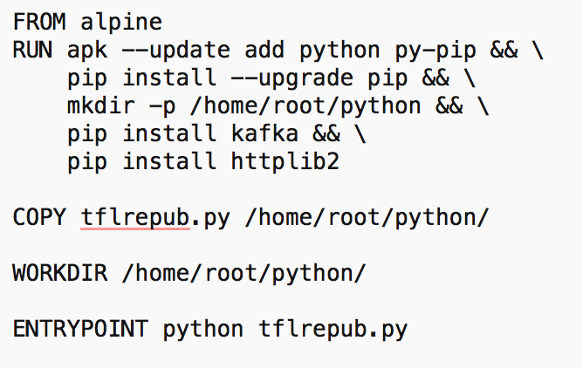
Dockerfile

Slide 12
Some simple Docker commands
apt-get install docker.io
docker pull ubuntu
docker run –t –i ubuntu /bin/bash
docker ps
docker commit funky_freo image
docker push image

Slide 13

Docker Compose
How to create a set of containers that work together

Slide 14

docker-compose.yml

Slide 15
Cloud Orchestration
What does an Operating System do?
Manages processes
Co-ordinates the processes access to resources
CPUs
Memory
Disk
Devices
Fairness and priority between processes

Slide 16
Datacenter Operating System aka Container Orchestration
Manages the placement of containers
Access to resources
Configuration and networking
Moves containers
Load balances across containers
Effectively creating a single OS across a cloud
Containers vs Processes

Slide 17

Kubernetes
Open Source cluster management of containers
From Google, but separate from the Borg project

Slide 18
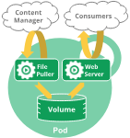
Pods
A Pod encapsulates an application container (or, in some cases, multiple containers), storage resources, a unique network IP, and options that govern how the container(s) should run.
A Pod represents a unit of deployment: a single instance of an application in Kubernetes, which might consist of either a single container or a small number of containers that are tightly coupled and that share resources.

Slide 19
Services
An abstract exposure of pods
Pods die and are recreated, replicated
“A Kubernetes Service is an abstraction which defines a logical set of Pods and a policy by which to access them”

Slide 20
Volumes
A persistent virtual disk that belongs to a Pod
Shares data between containers
Lives longer than a container, but no longer than the pod

Slide 21
Namespaces
A virtual cluster
Names must be unique inside namespaces, can be the same across different namespaces

Slide 22

DevOps

Slide 23
DevOps
DevOps is the codification of the interface between Development and Operations
Agile
Repeatable
Collaborative
Versioned
Automated

Slide 24


Kittens vs Cattle (An unpleasant but effective analogy)

Slide 25
Immutability
Never change a running server
Only create a new one that is better
Track the changes in a version control model

Slide 26

Blue Green Deployment
http://martinfowler.com/bliki/BlueGreenDeployment.html

Slide 27
DevOps and Docker
Docker is a key DevOps tool
Speeds up the creation of repeatable deployments
Consistency between development, test and production
Versioned repository
Works with Chef, Puppet, etc

Slide 28
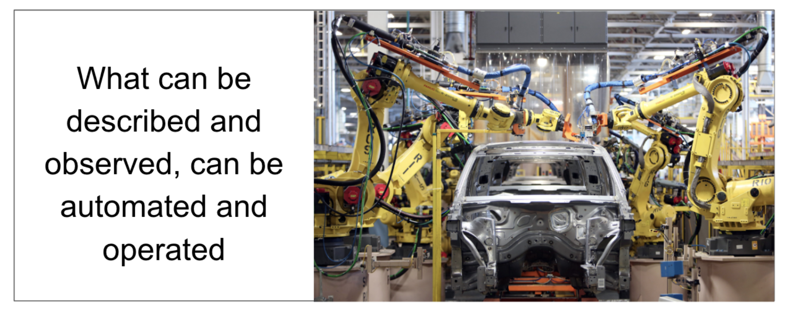
https://www.weave.works/blog/gitops-git-push-all-the-things

Slide 29
GitOps
Infrastructure as Code
Terraform + Deployment + Containers + Build
Everything is in Git
Any change to the infrastructure is a Pull Request

Slide 30

http://12factor.net

Slide 31
12 Factor Apps
Codebase
One codebase in revision control, many deploys
Dependencies
Explicity define and declare
Config
Store config in the environment
Backing Services
Treat as attached resources
Build, Release, Run
Strictly separate
Processes
Execute the app as stateless processes
Port Binding
Export services via port binding
Concurrency
Scale out via processes
Disposability
Fast startup and graceful shutdown
Dev/Prod Parity
Keep dev/staging/prod as similar as possible
Logs
Treat logs as event streams
Admin Processes
Run admin/mgmt tasks as one-off processes

Slide 32
Summary
Docker and the Container model
Lightweight virtualization and repeatability
Blue Green deployment
“Warehouse Scale” computing

